Slide 1

Accounting for Variance in Machine Learning Benchmarks
Xavier Bouthillier

Slide 2
Quick word about me and my team

Slide 3




My Team’s Mission
Accelerate AI research by creating a strong and cutting-edge technological environment for the needs of AI researchers at Mila and beyond.
IT Environment | Computing Infrastructure | Software, Tooling and Innovation
Access control and Identity mgmt Wifi and common peripherals Common Software Services Helpdesk | Local GPU computing cluster Deep learning software stack mgmt Dataset mgmt Hardware tech watch and expertise | New tools for AI research Research methodology Technical know-how / expertise Training and counsel
IDT - INNOVATION, DEVELOPMENT AND TECHNOLOGIES

Slide 4
Accounting for Variance in Machine Learning Benchmarks

Slide 5
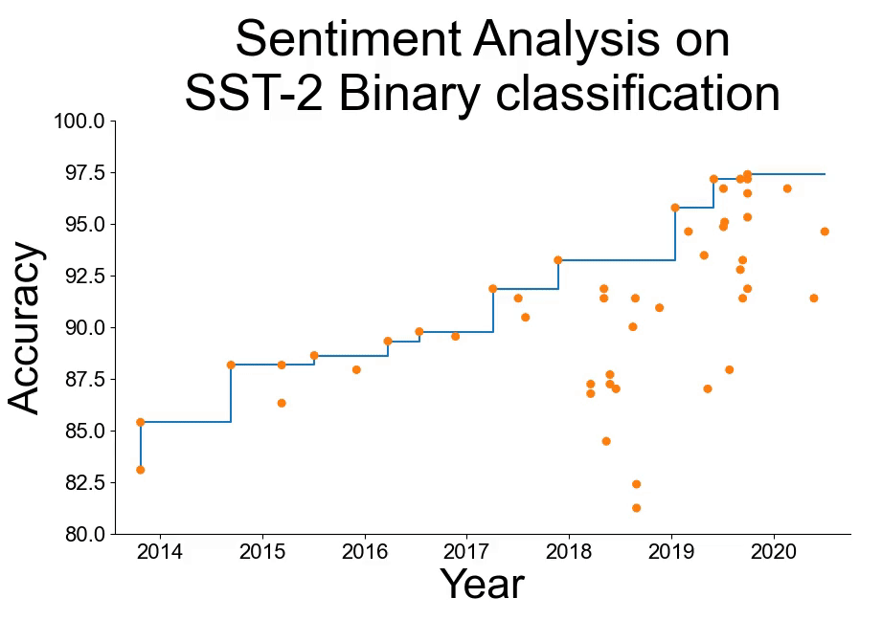
From paperswithcode.com

Slide 6
From paperswithcode.com

Slide 7
Overview
Accounting for variance in machine learning benchmarks
What are the different sources of variance and are they significant?
Statistical testing 101
Statistical tests for ML
Hyperparameter optimization
Statistical testing and HPO
Search Space
Choosing the right budget and right HPO algorithm
Tips for running HPO efficiently
Visualization of HPO results

Slide 8
Sources of variance in ML benchmarks
Data sampling for training and model selection
Internal sources of variation (ex: dropout, weights initialization)
System noise (ex: order of operations, concurrent processes)
Hyperparameter optimization

Slide 9
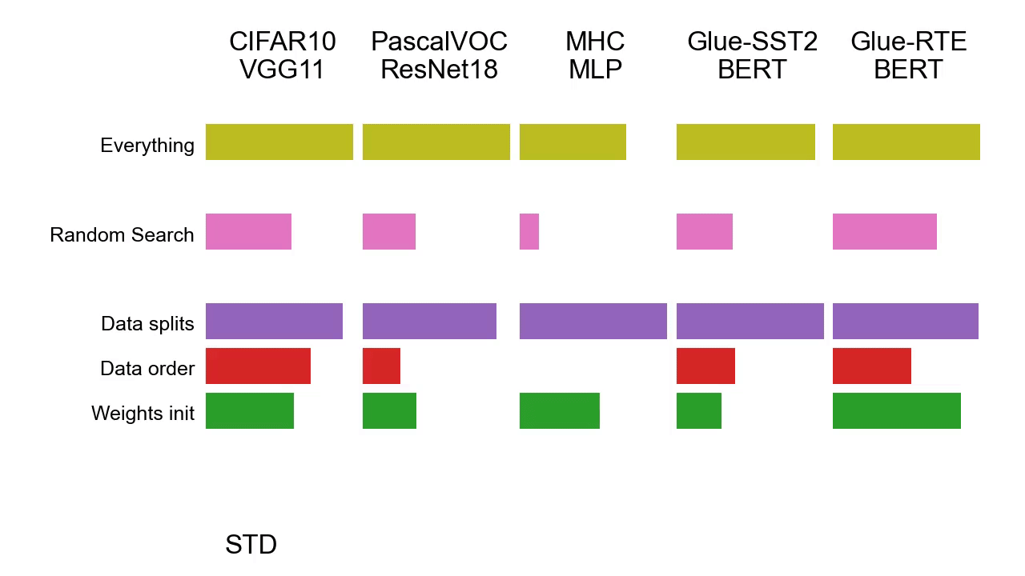
Importance of the sources of variance
Bouthillier et al. "Accounting for variance in machine learning benchmarks." Proceedings of Machine Learning and Systems 3 (2021): 747-769.

Slide 10
Importance of the sources of variance
Most of common sources of variance are important!
Bouthillier et al. "Accounting for variance in machine learning benchmarks." Proceedings of Machine Learning and Systems 3 (2021): 747-769.

Slide 11
How can we handle noise in benchmarks?
Randomize to account for these!
Use statistical tests to differentiate significant differences from statistical flukes

Slide 12
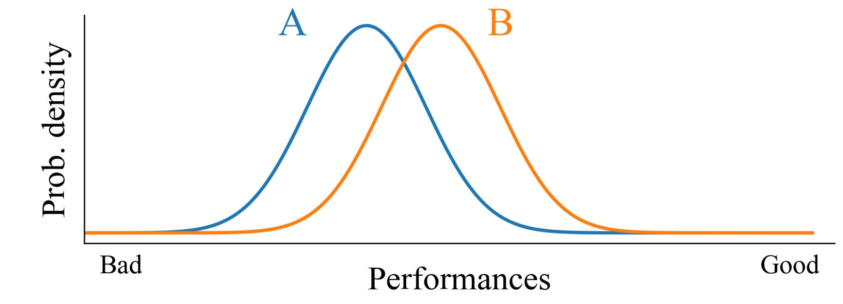
Statistical testing
We have two learning algorithms for which we measure their performance. We want to determine whether B is better than A. It’s simple here, we see the distributions.

Slide 13
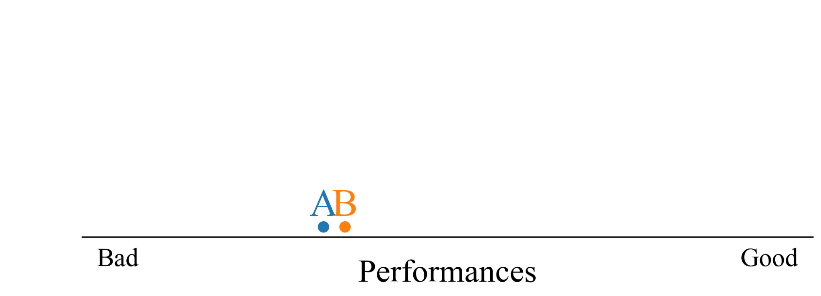
Statistical testing
But in practice we only have access to the samples. The samples being measures of performance during independent runs.

Slide 14
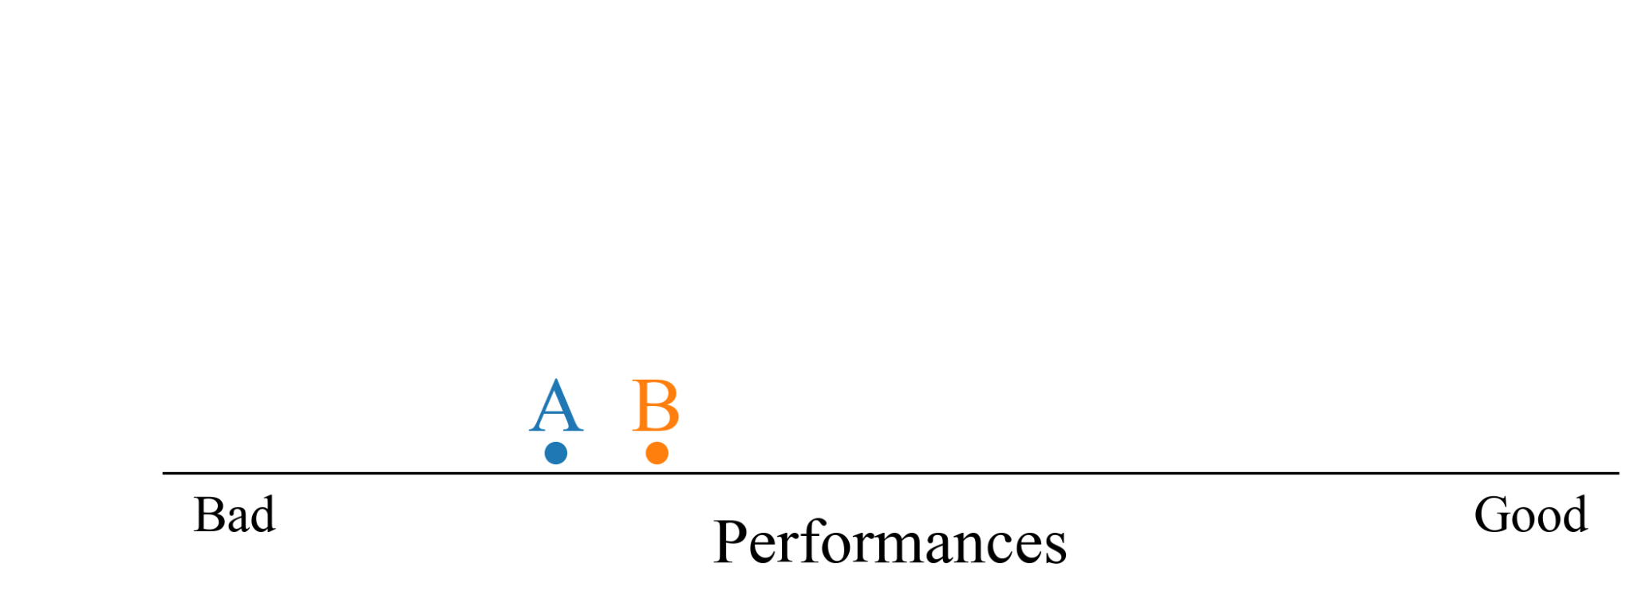
Statistical testing
But in practice we only have access to the samples. The samples being measures of performance during independent runs.
Is B better than A?

Slide 15

Statistical testing
But in practice we only have access to the samples. The samples being measures of performance during independent runs.
Is B better than A?
Is it?

Slide 16
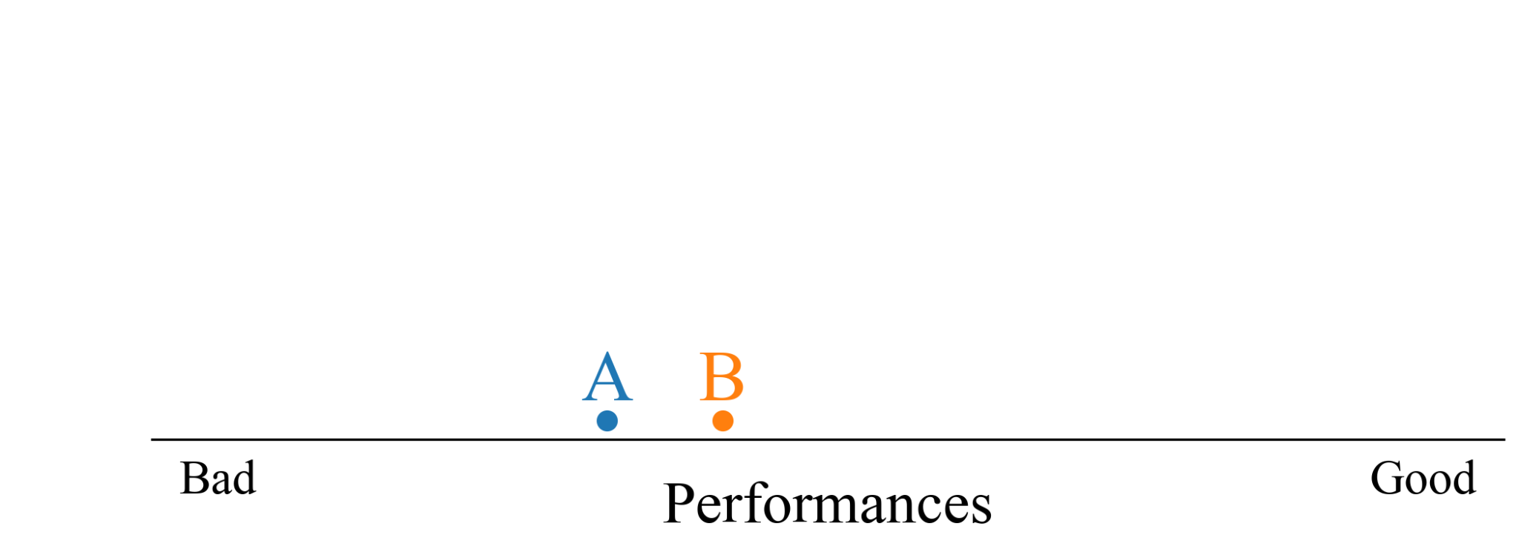
Statistical testing
But in practice we only have access to the samples. The samples being measures of performance during independent runs.
Is B better than A?
Is it?

Slide 17

Statistical testing
But in practice we only have access to the samples. The samples being measures of performance during independent runs.
Is B better than A?
Is it?
Really?

Slide 18
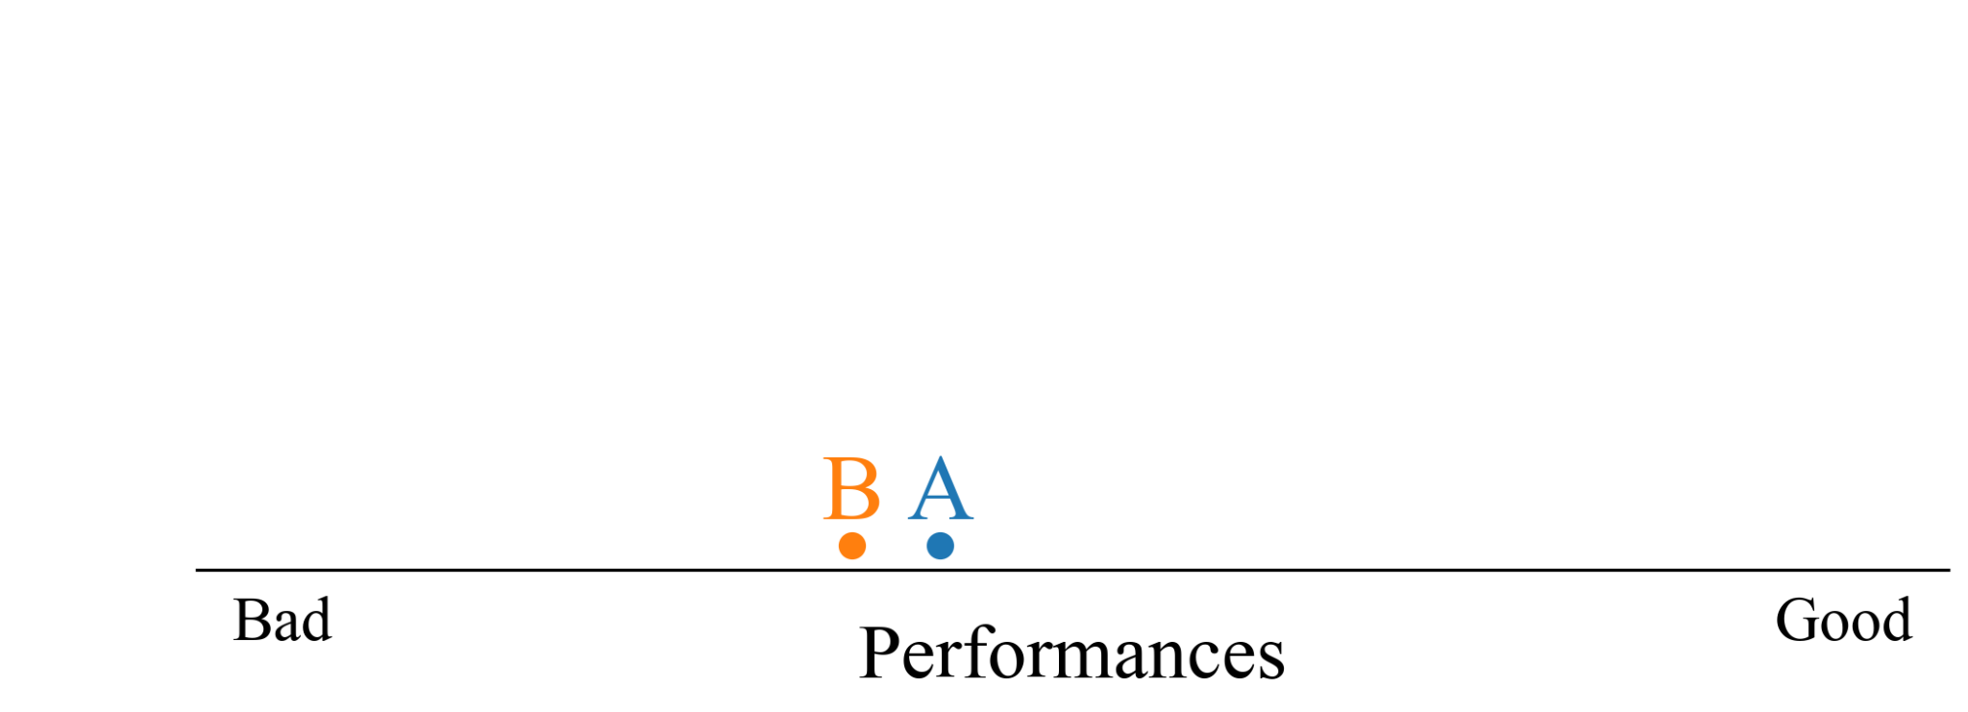
Statistical testing
But in practice we only have access to the samples. The samples being measures of performance during independent runs.
Is B better than A?
Is it?
Really?

Slide 19

Statistical testing
But in practice we only have access to the samples. The samples being measures of performance during independent runs.
Is B better than A?
Is it?
Really?
How can I know for sure?

Slide 20

Statistical testing
But in practice we only have access to the samples. The samples being measures of performance during independent runs.
Is B better than A?
Is it?
Really?
How can I know for sure?

Slide 21
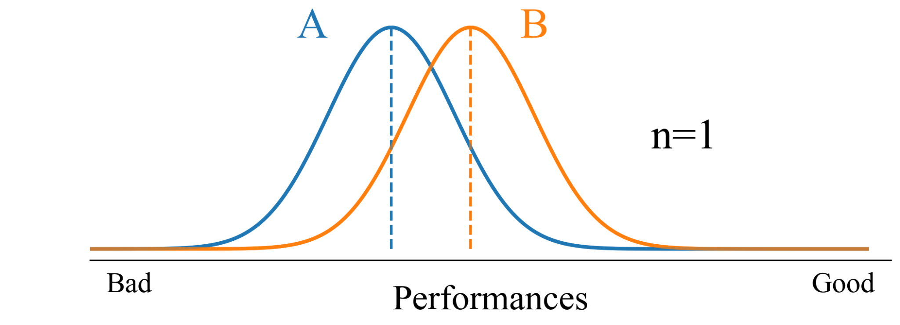
Statistical testing
First thing we typically think of, is computing an average performance over multiple runs.
This mean itself has a distribution, each time we execute 10 runs we end up with a slightly different mean.
So, how many runs should we make?

Slide 22
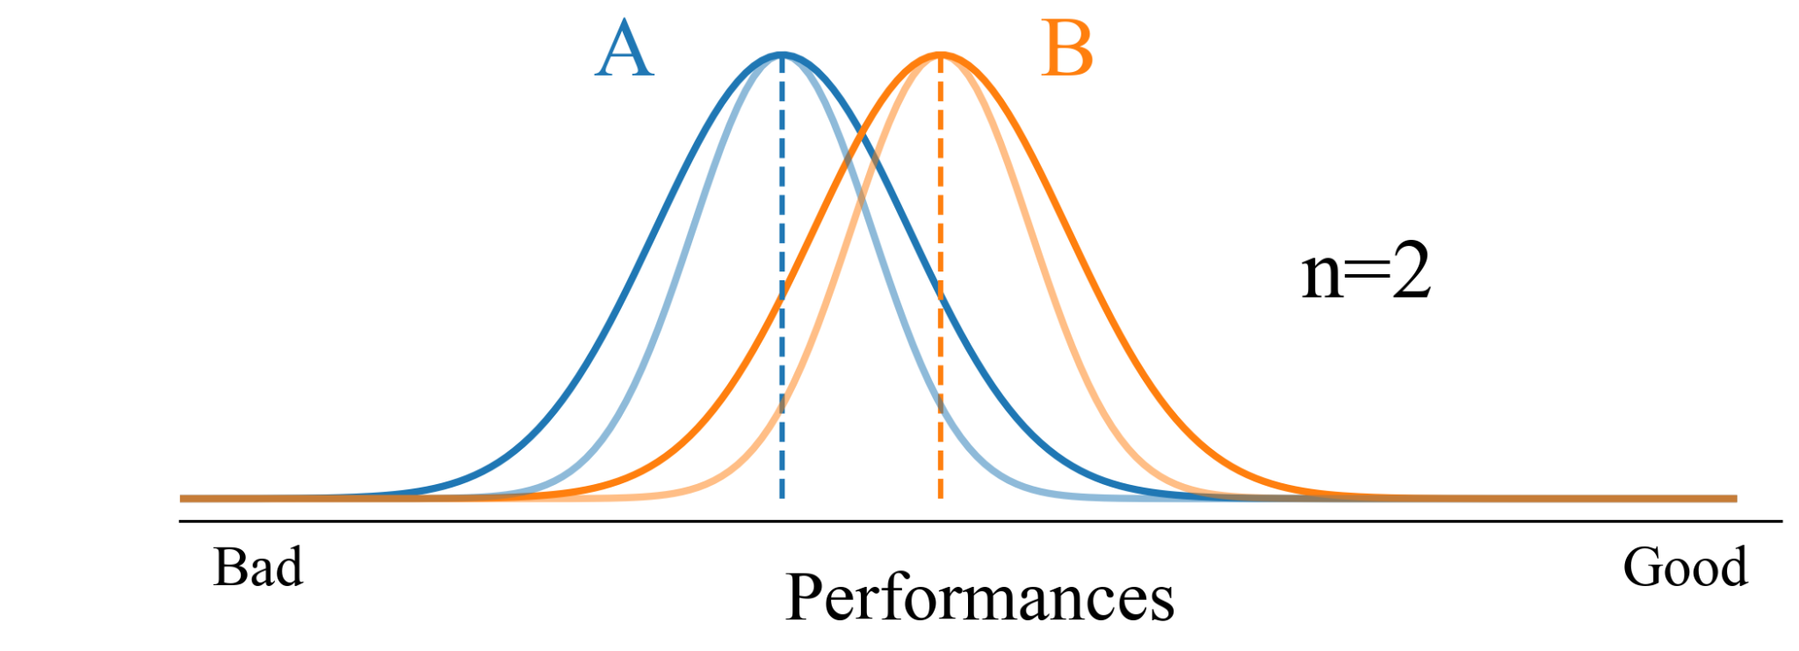
Statistical testing
First thing we typically think of, is computing an average performance over multiple runs.
This mean itself has a distribution, each time we execute 10 runs we end up with a slightly different mean.
So, how many runs should we make?

Slide 23
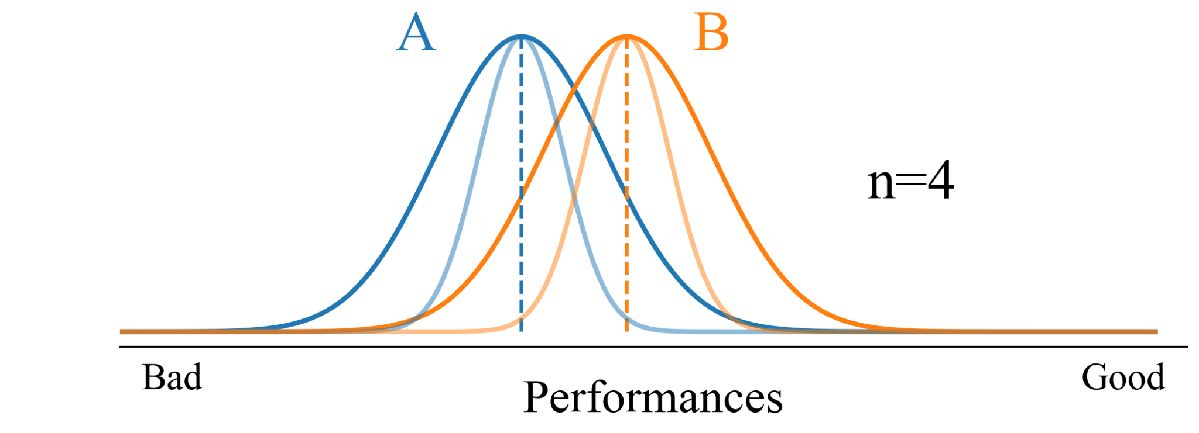
Statistical testing
First thing we typically think of, is computing an average performance over multiple runs.
This mean itself has a distribution, each time we execute 10 runs we end up with a slightly different mean.
So, how many runs should we make?

Slide 24
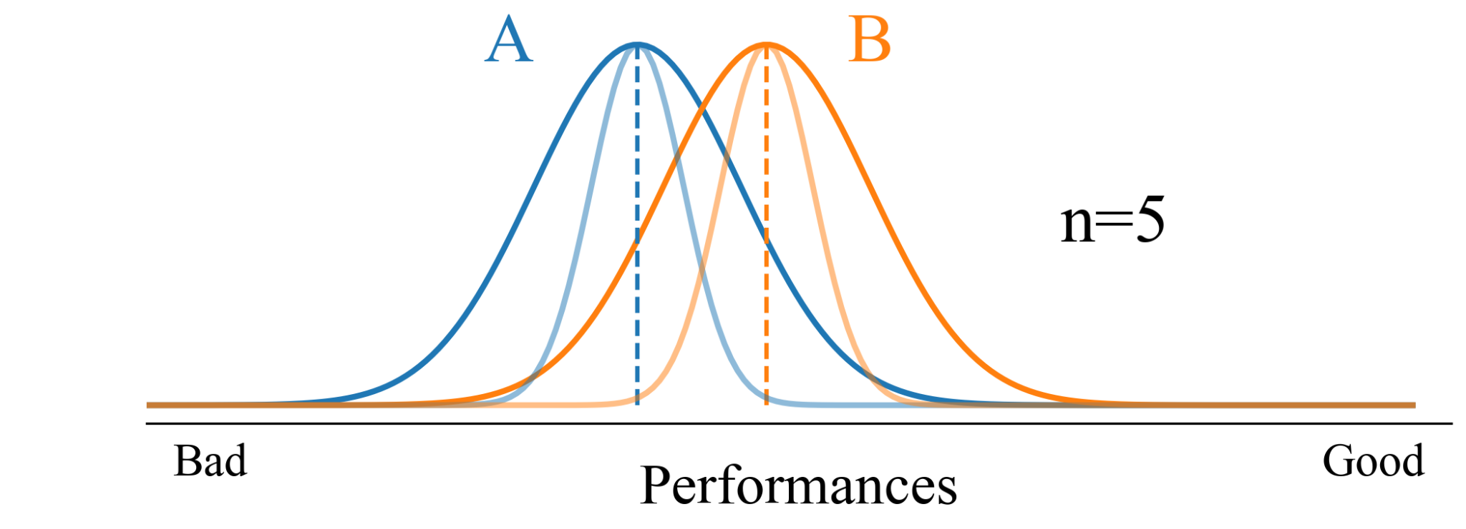
Statistical testing
First thing we typically think of, is computing an average performance over multiple runs.
This mean itself has a distribution, each time we execute 10 runs we end up with a slightly different mean.
So, how many runs should we make?

Slide 25
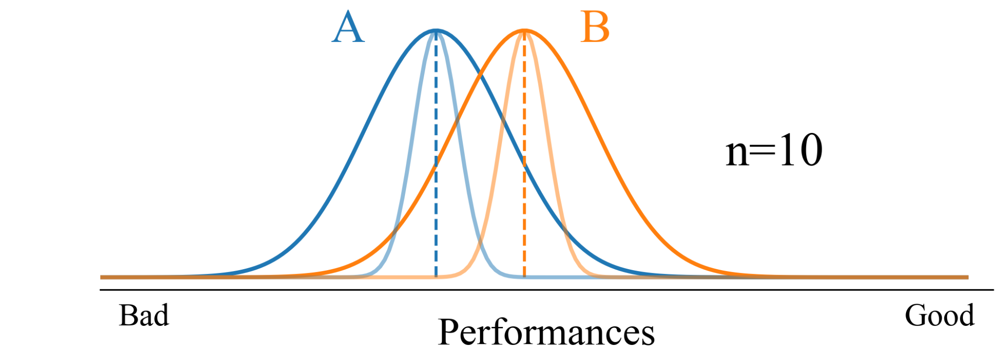
Statistical testing
First thing we typically think of, is computing an average performance over multiple runs.
This mean itself has a distribution, each time we execute 10 runs we end up with a slightly different mean.
So, how many runs should we make?

Slide 26
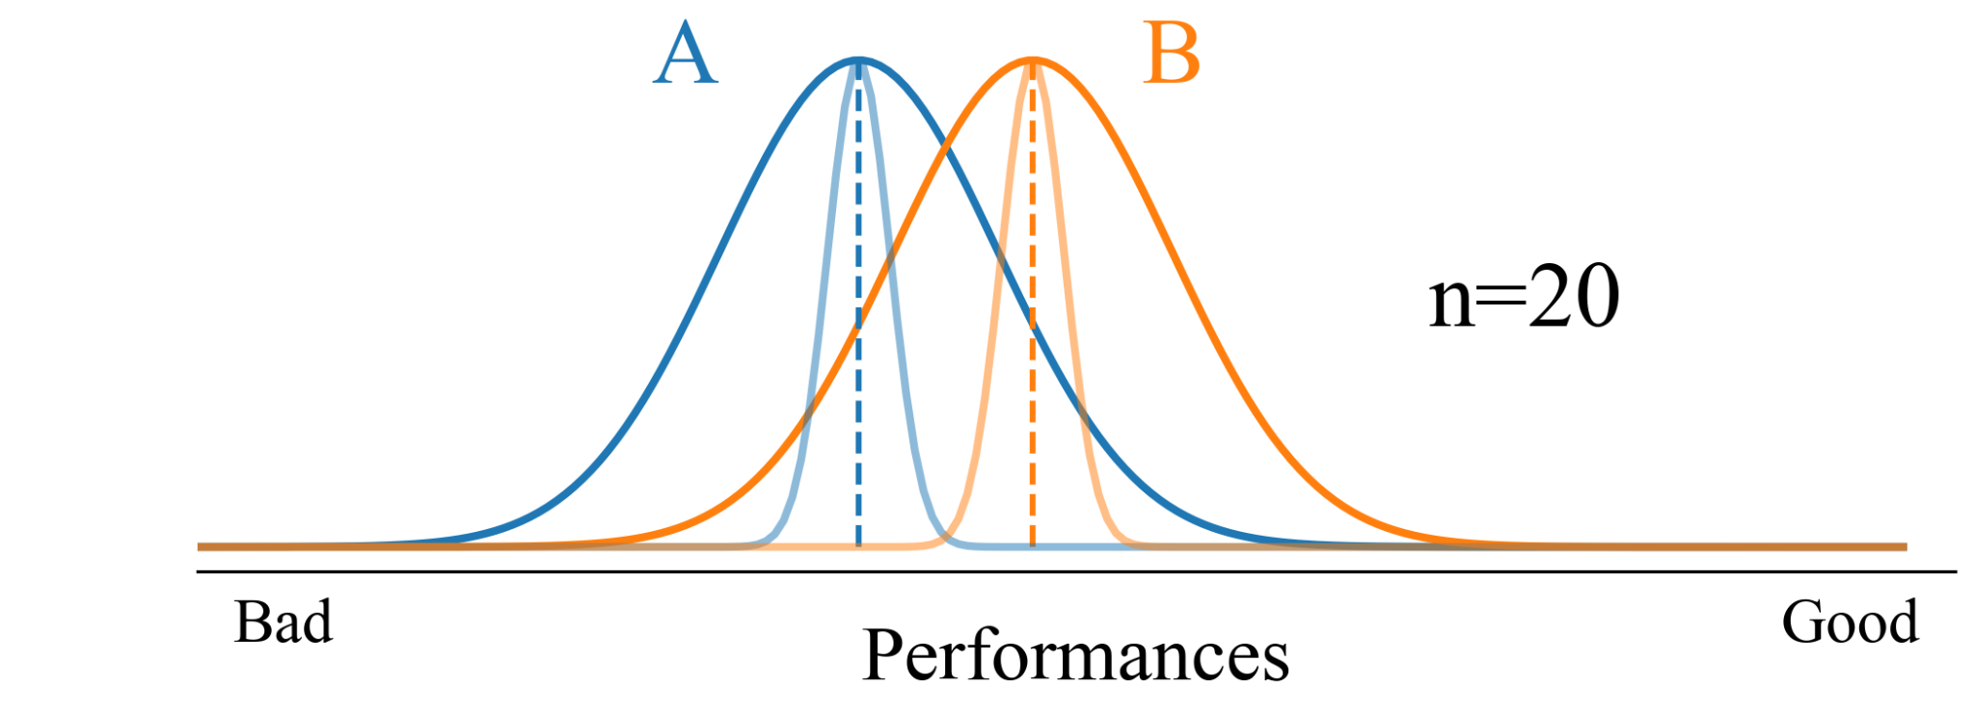
Statistical testing
First thing we typically think of, is computing an average performance over multiple runs.
This mean itself has a distribution, each time we execute 10 runs we end up with a slightly different mean.
So, how many runs should we make?

Slide 27
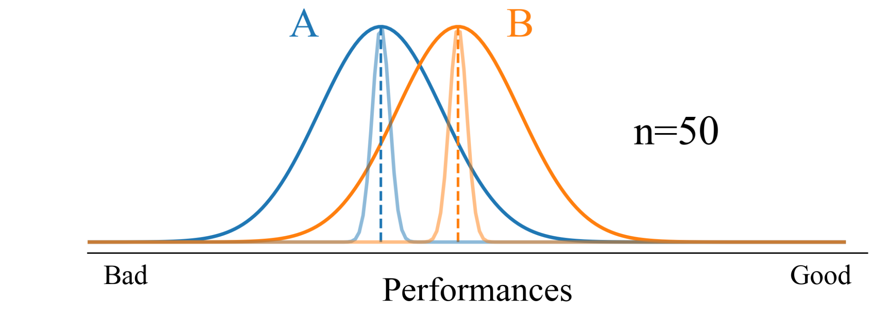
Statistical testing
First thing we typically think of, is computing an average performance over multiple runs.
This mean itself has a distribution, each time we execute 10 runs we end up with a slightly different mean.
So, how many runs should we make?

Slide 28
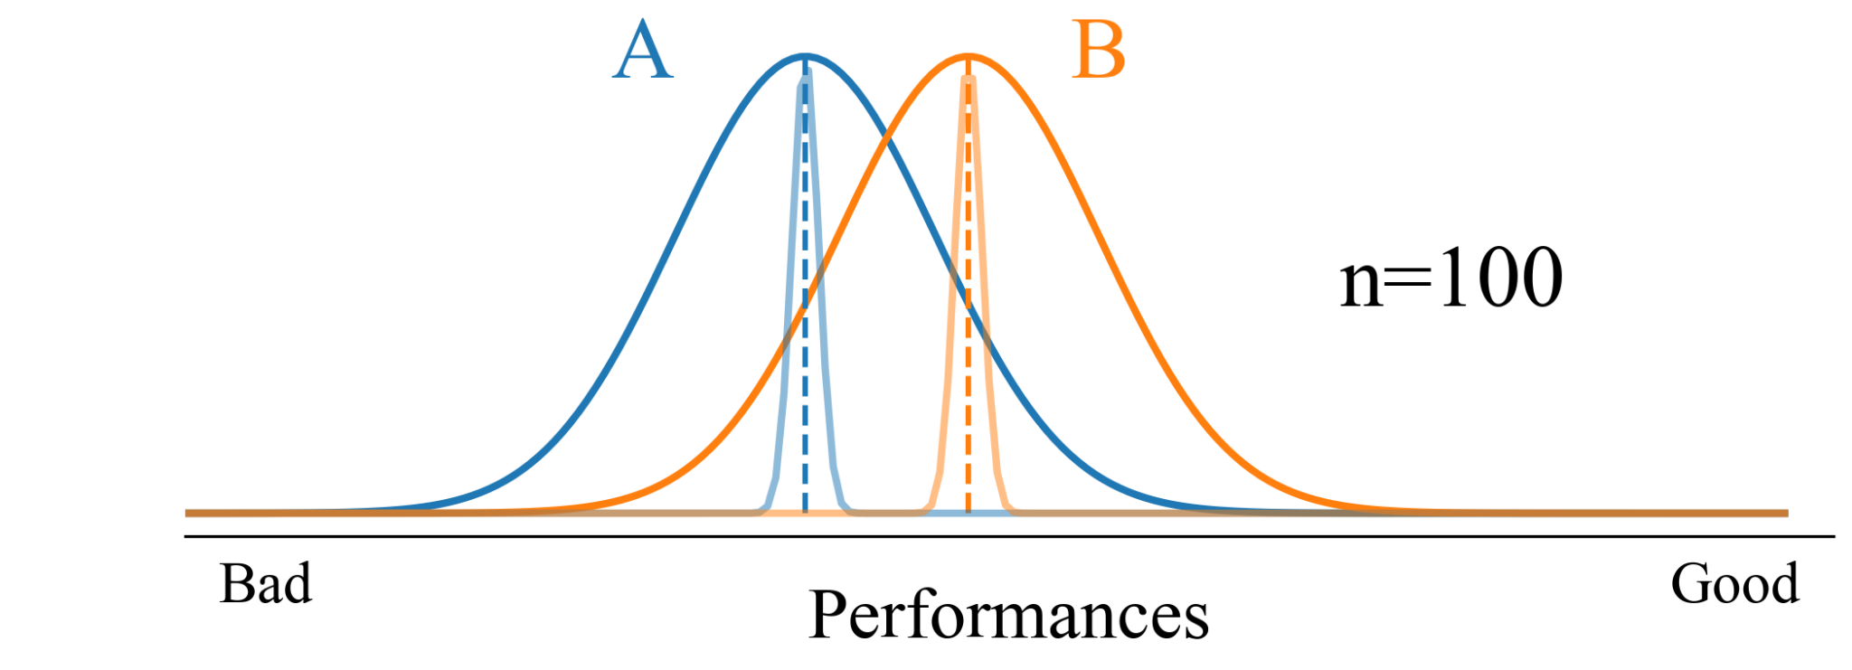
Statistical testing
First thing we typically think of, is computing an average performance over multiple runs.
This mean itself has a distribution, each time we execute 10 runs we end up with a slightly different mean.
So, how many runs should we make?

Slide 29
Statistical testing
First thing we typically think of, is computing an average performance over multiple runs.
This mean itself has a distribution, each time we execute 10 runs we end up with a slightly different mean.
So, how many runs should we make?
And how can I know 2 means are
significantly different?

Slide 30
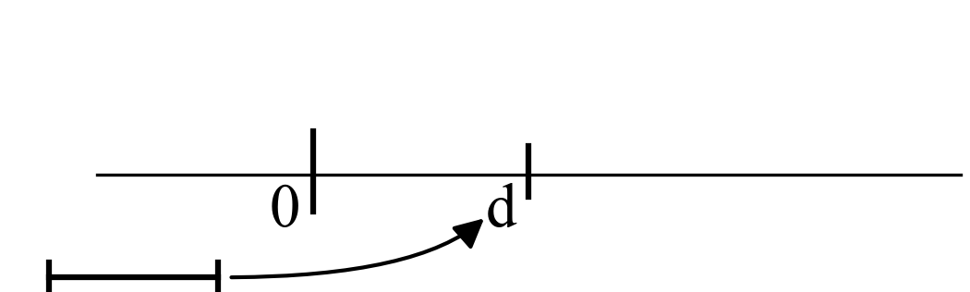
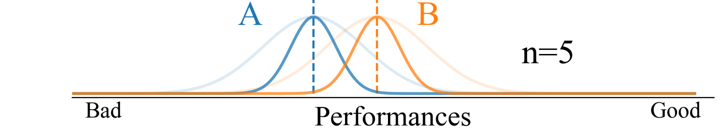
Null-hypothesis
We compute the difference between these means.

Slide 31
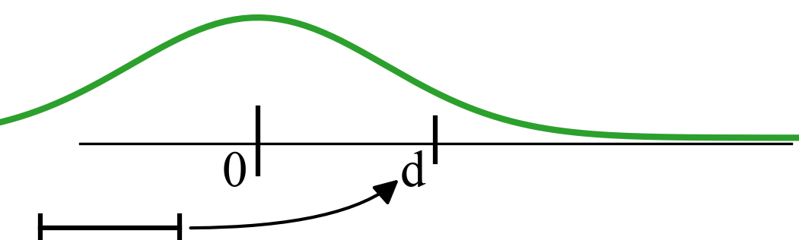
Null-hypothesis
We compute the difference between these means.
And we model our null-hypothesis.

Slide 32
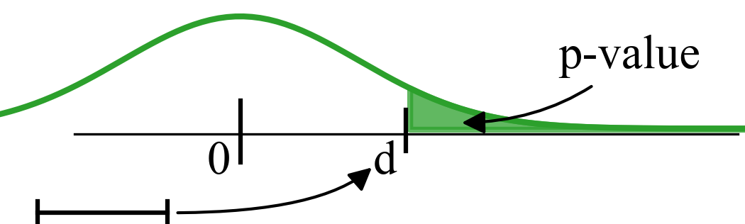
Null-hypothesis
We compute the difference between these means.
And we model our null-hypothesis.
Now enters the controversial p-value.

Slide 33
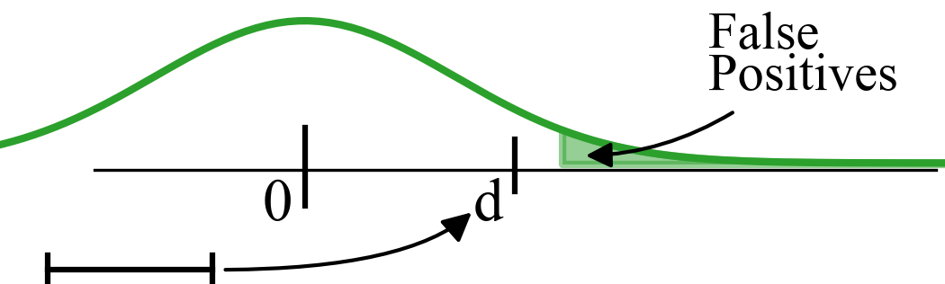
Null-hypothesis
We control the rate of false positives, by stating that the p-value should be below some value alpha, typically 0.05.

Slide 34
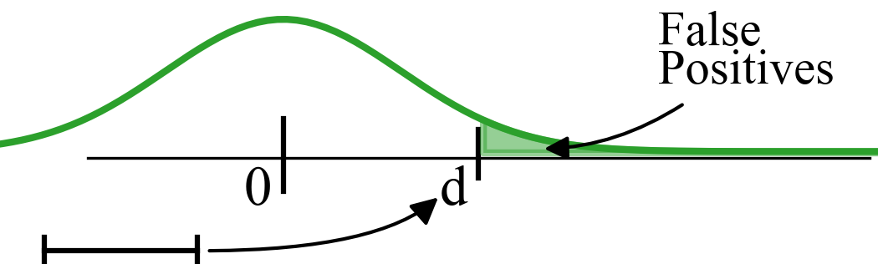
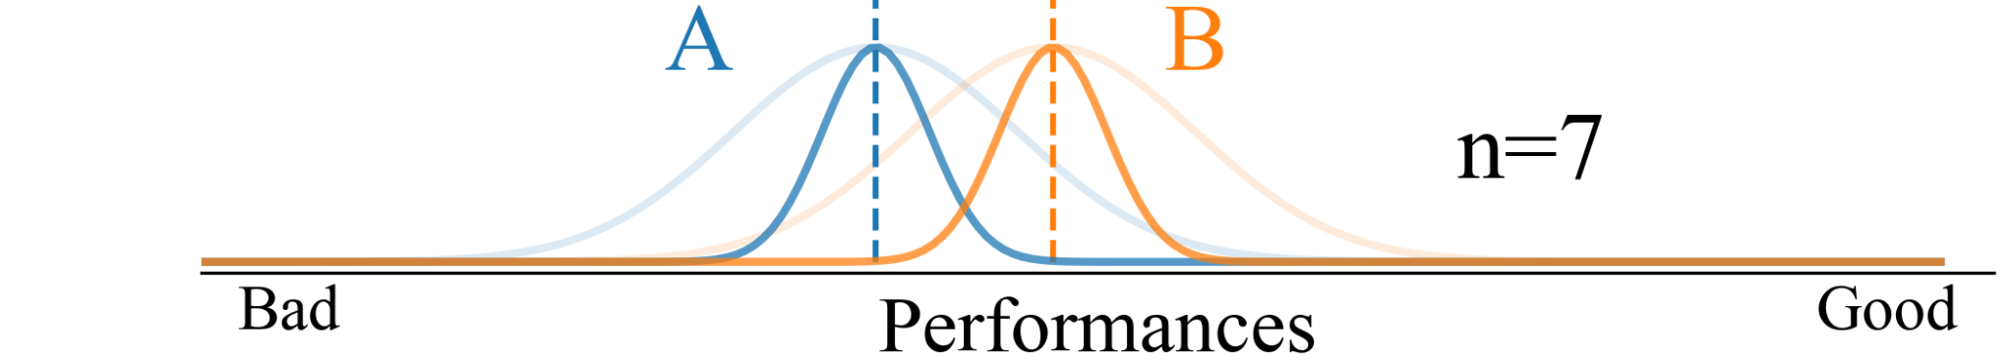
Null-hypothesis
We control the rate of false positives, by stating that the p-value should be below some value alpha, typically 0.05.
As we decrease the variance, the p-value decrease.

Slide 35
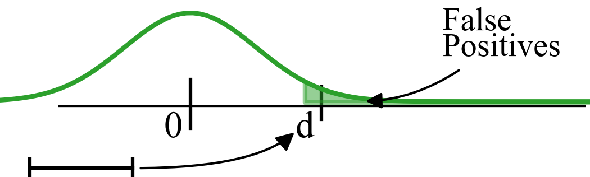
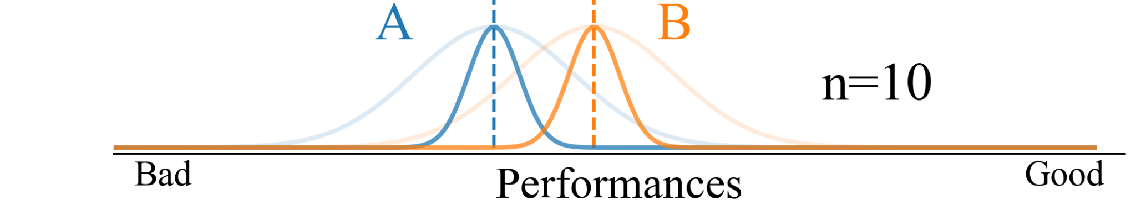
Null-hypothesis
We control the rate of false positives, by stating that the p-value should be below some value alpha, typically 0.05.
As we decrease the variance, the p-value decrease.

Slide 36
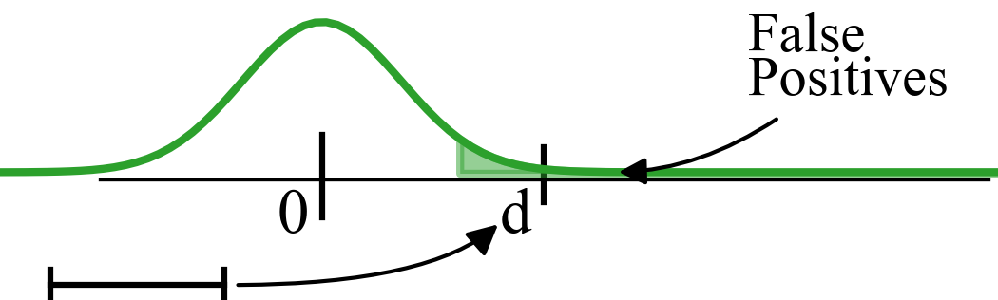
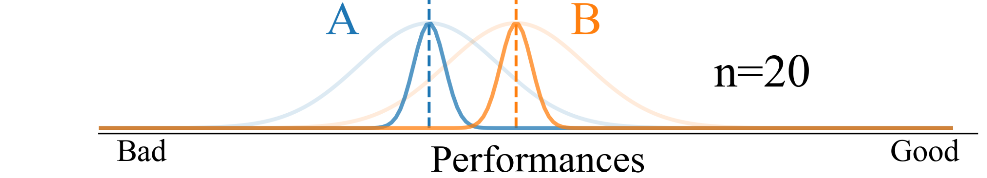
Null-hypothesis
We control the rate of false positives, by stating that the p-value should be below some value alpha, typically 0.05.
As we decrease the variance, the p-value decrease.

Slide 37
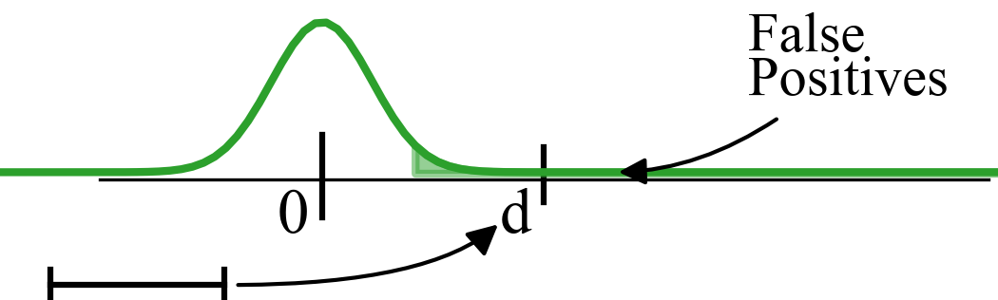
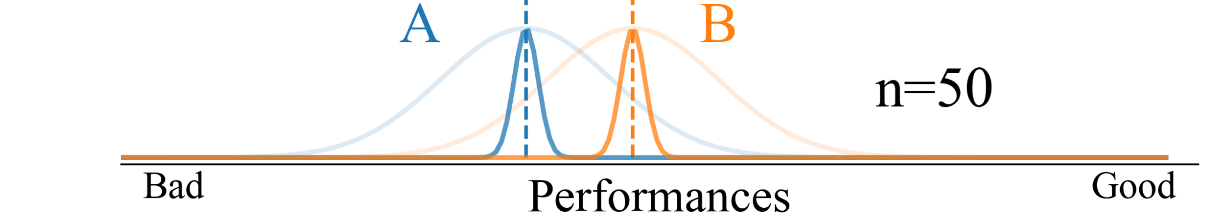
Null-hypothesis
We control the rate of false positives, by stating that the p-value should be below some value alpha, typically 0.05.
As we decrease the variance, the p-value decrease.

Slide 38
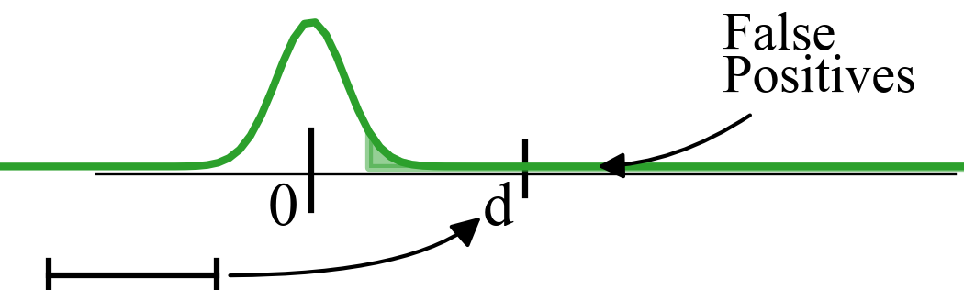

Null-hypothesis
However doing so we can
detect any tiny differences,
as meaningless as they may be.

Slide 39
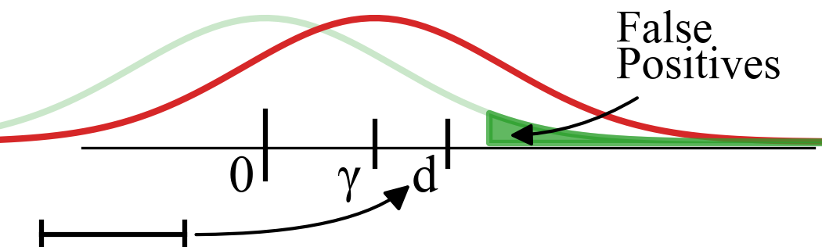
Alternative hypothesis
Now enters the alternative hypothesis.
We define a meaningful difference, gamma.

Slide 40
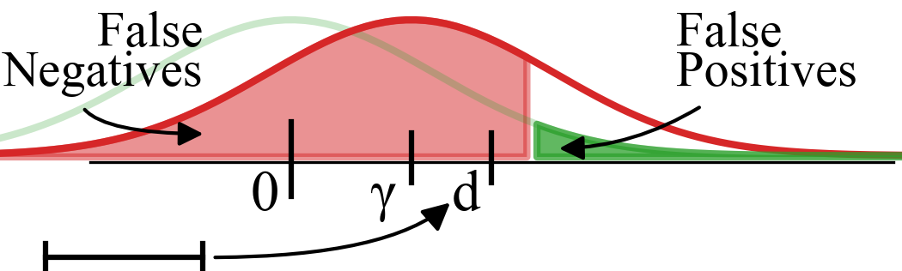
Alternative hypothesis
We want to control the rate of false negatives if the alternative hypothesis is true. This control is also known as the statistical power.

Slide 41
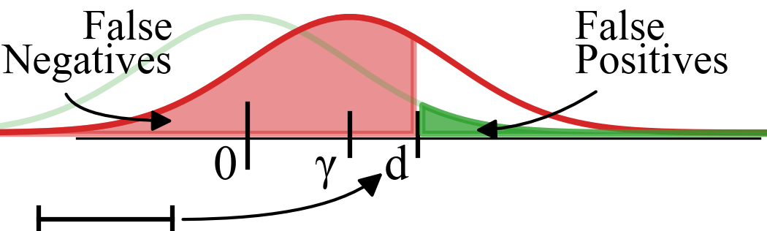
Alternative hypothesis
We want to control the rate of false negatives if the alternative hypothesis is true. This control is also known as the statistical power.
To do so, we increase the sample size until we reach the rate of false negatives we seek.

Slide 42
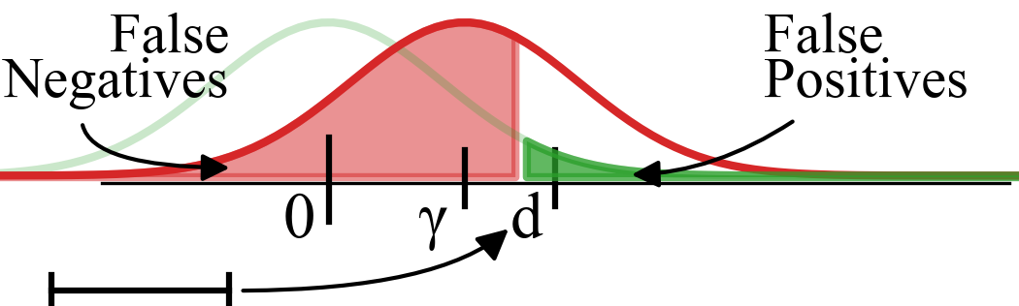
Alternative hypothesis
We want to control the rate of false negatives if the alternative hypothesis is true. This control is also known as the statistical power.
To do so, we increase the sample size until we reach the rate of false negatives we seek.

Slide 43
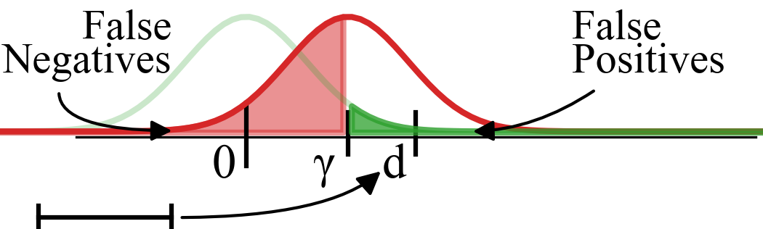
Alternative hypothesis
We want to control the rate of false negatives if the alternative hypothesis is true. This control is also known as the statistical power.
To do so, we increase the sample size until we reach the rate of false negatives we seek.

Slide 44
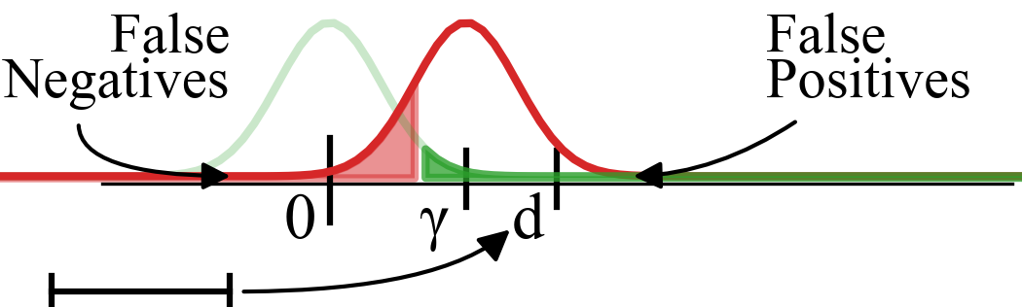
Alternative hypothesis
We want to control the rate of false negatives if the alternative hypothesis is true. This control is also known as the statistical power.
To do so, we increase the sample size until we reach the rate of false negatives we seek.

Slide 45
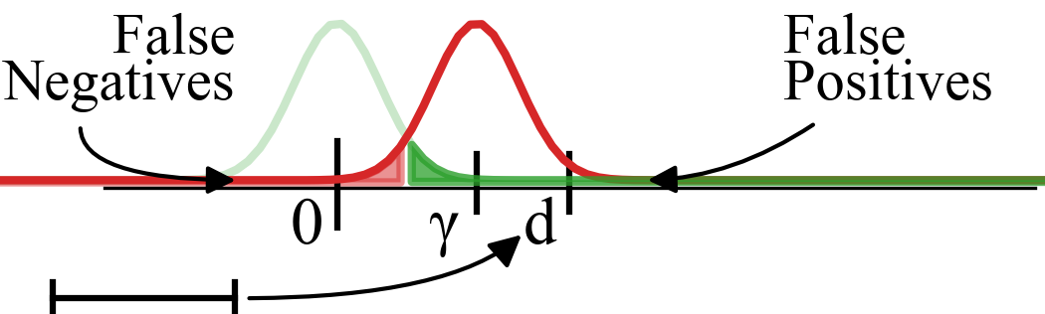
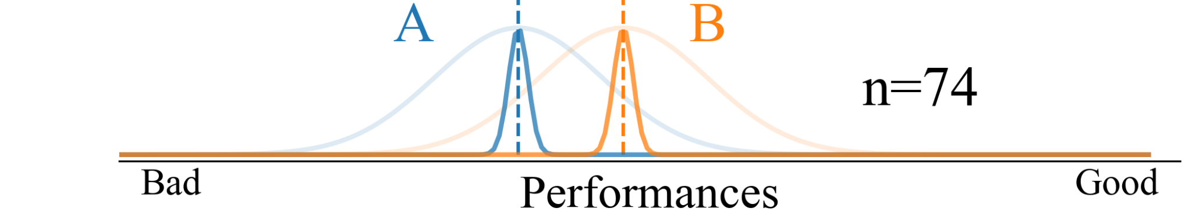
Alternative hypothesis
We want to control the rate of false negatives if the alternative hypothesis is true. This control is also known as the statistical power.
To do so, we increase the sample size until we reach the rate of false negatives we seek.

Slide 46
Alternative hypothesis
We want to control the rate of false negatives if the alternative hypothesis is true. This control is also known as the statistical power.
To do so, we increase the sample size until we reach the rate of false negatives we seek.
Sample size determination is not a rule of thumb.
It is critical.

Slide 47
Summary
Null hypothesis allows to rule out results that could be explained by noise. If the p-value is below the critical value, then we reject the null hypothesis.
It does not say how precise the test should be. This is governed by the alternative hypothesis and sample size determination.
Sample size determination is computed based on the Neyman-Pearson Lemma.
It will depend on the type of test, variance, and the value of gamma.

Slide 48
Some statistical tests for ML
McNemar
Good for situations where you only have access to models and cannot retrain them.
T-test
Good for situations where the distribution of performances is close to a normal distribution.
Mann-Whitney U-test (Using probability index variant)
Good for situations where the distribution is not close to a normal distribution.

Slide 49
Repetitions
Original
Sampled sets
Cross-validation
Shuffle examples and divide in n equal sets.
Out-of-bootstrap
Sample with replacement, without reusing examples across sets.

Slide 50
Repetitions
Cross-validation
Shuffle examples and divide in n equal sets.
Out-of-bootstrap
Sample with replacement, without reusing examples across sets.
+ Use all data
+ No duplicate examples
- Induces correlation when n is large.
(Equivalent to sampling without replacement)
(Diettrich recommends no more than
5 repetitions for datasets of size < 1000 )
+ Induces less correlation when n is large.
- Do not use all data
- Duplicate examples

Slide 51
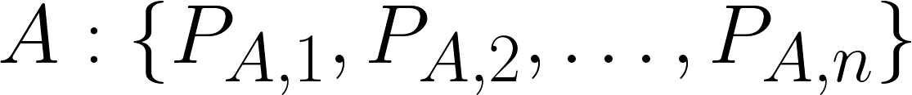
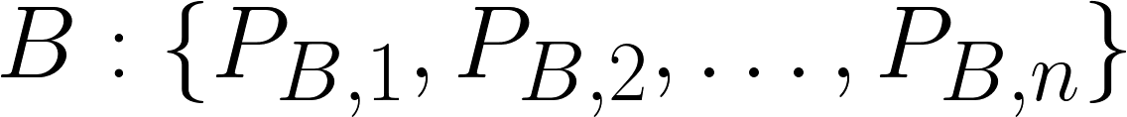


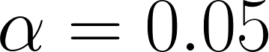
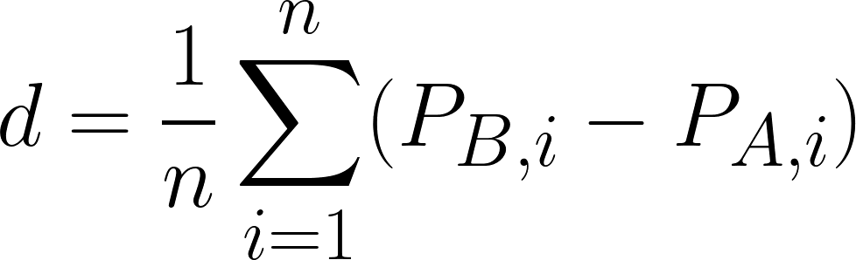
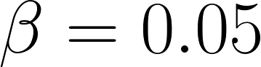
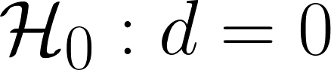
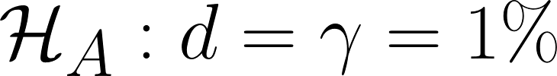
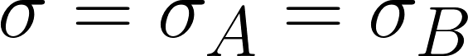
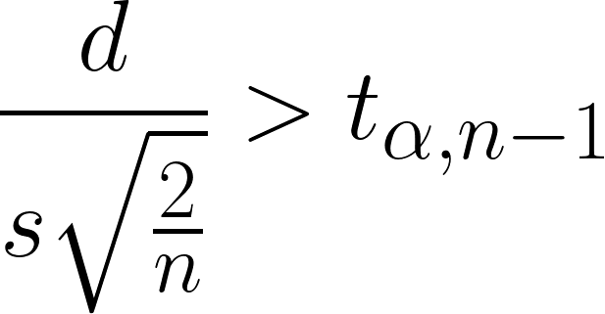
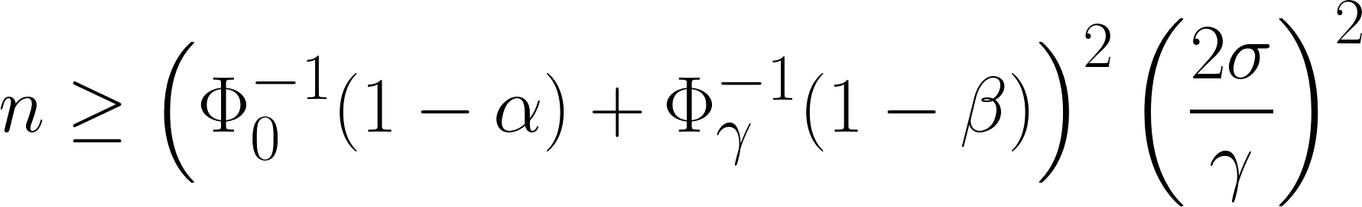
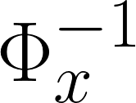
Some good statistical tests for ML:
T-test
4. We train n models for each learning algorithms
5. Then compute the average paired difference
6. We compute the t statistic and compare with
critical value
1. We have learning algorithms and
2. We set false positives at
false negatives at
null hypothesis
alternative hypothesis
We assume variance of
performances are equal
3. Based on this we compute
the minimal sample size
Where is the inverse cumulative distribution function centered in

Slide 52
Some good statistical tests for ML:
T-test
4. We train n models for each learning algorithms
5. Then compute the average paired difference
6. We compute the t statistic and compare with
critical value
1. We have learning algorithms and
2. We set false positives at
false negatives at
null hypothesis
alternative hypothesis
We assume variance of
performances are equal
3. Based on this we compute
the minimal sample size
Where is the inverse cumulative distribution function centered in

Slide 53
Some good statistical tests for ML:
T-test
4. We train n models for each learning algorithms
5. Then compute the average paired difference
6. We compute the t statistic and compare with
critical value
1. We have learning algorithms and
2. We set false positives at
false negatives at
null hypothesis
alternative hypothesis
We assume variance of
performances are equal
3. Based on this we compute
the minimal sample size
Where is the inverse cumulative distribution function centered in

Slide 54
Some good statistical tests for ML:
T-test
4. We train n models for each learning algorithms
5. Then compute the average paired difference
6. We compute the t statistic and compare with
critical value
1. We have learning algorithms and
2. We set false positives at
false negatives at
null hypothesis
alternative hypothesis
We assume variance of
performances are equal
3. Based on this we compute
the minimal sample size
Where is the inverse cumulative distribution function centered in

Slide 55
Some good statistical tests for ML:
T-test
4. We train n models for each learning algorithms
5. Then compute the average paired difference
6. We compute the t statistic and compare with
critical value
1. We have learning algorithms and
2. We set false positives at
false negatives at
null hypothesis
alternative hypothesis
We assume variance of
performances are equal
3. Based on this we compute
the minimal sample size
Where is the inverse cumulative distribution function centered in

Slide 56
Some good statistical tests for ML:
T-test
4. We train n models for each learning algorithms
5. Then compute the average paired difference
6. We compute the t statistic and compare with
critical value
1. We have learning algorithms and
2. We set false positives at
false negatives at
null hypothesis
alternative hypothesis
We assume variance of
performances are equal
3. Based on this we compute
the minimal sample size
Where is the inverse cumulative distribution function centered in

Slide 57
Some good statistical tests for ML:
T-test
4. We train n models for each learning algorithms
5. Then compute the average paired difference
6. We compute the t statistic and compare with
critical value
1. We have learning algorithms and
2. We set false positives at
false negatives at
null hypothesis
alternative hypothesis
We assume variance of
performances are equal
3. Based on this we compute
the minimal sample size
Where is the inverse cumulative distribution function centered in

Slide 58
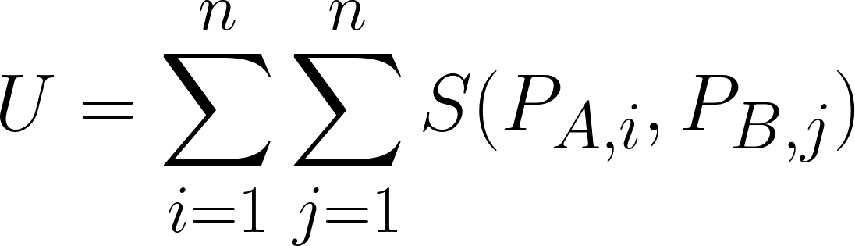
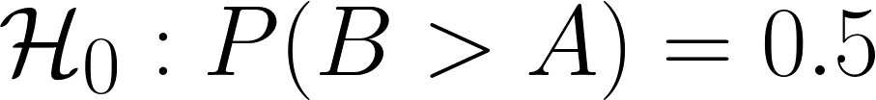



Some good statistical tests for ML:
Mann-Whitney U-test
4. We train n models for each learning algorithms
5. Then compute the U statistic
where
6. And compare with critical value
1. We have learning algorithms and
2. We set false positives at
false negatives at
null hypothesis
alternative hypothesis
3. Based on this we compute
the minimal sample size
Where is the inverse cumulative distribution function centered in

Slide 59
Some good statistical tests for ML:
Mann-Whitney U-test
4. We train n models for each learning algorithms
5. Then compute the U statistic
where
6. And compare with critical value
1. We have learning algorithms and
2. We set false positives at
false negatives at
null hypothesis
alternative hypothesis
3. Based on this we compute
the minimal sample size
Where is the inverse cumulative distribution function centered in

Slide 60
Some good statistical tests for ML:
Mann-Whitney U-test
4. We train n models for each learning algorithms
5. Then compute the U statistic
where
6. And compare with critical value
1. We have learning algorithms and
2. We set false positives at
false negatives at
null hypothesis
alternative hypothesis
3. Based on this we compute
the minimal sample size
Where is the inverse cumulative distribution function centered in

Slide 61
Some good statistical tests for ML:
Mann-Whitney U-test
4. We train n models for each learning algorithms
5. Then compute the U statistic
where
6. And compare with critical value
1. We have learning algorithms and
2. We set false positives at
false negatives at
null hypothesis
alternative hypothesis
3. Based on this we compute
the minimal sample size
Where is the inverse cumulative distribution function centered in

Slide 62
Some good statistical tests for ML:
Mann-Whitney U-test
4. We train n models for each learning algorithms
5. Then compute the U statistic
where
6. And compare with critical value
1. We have learning algorithms and
2. We set false positives at
false negatives at
null hypothesis
alternative hypothesis
3. Based on this we compute
the minimal sample size
Where is the inverse cumulative distribution function centered in

Slide 63
Some good statistical tests for ML:
Mann-Whitney U-test
4. We train n models for each learning algorithms
5. Then compute the U statistic
where
6. And compare with critical value
1. We have learning algorithms and
2. We set false positives at
false negatives at
null hypothesis
alternative hypothesis
3. Based on this we compute
the minimal sample size
Where is the inverse cumulative distribution function centered in

Slide 64
Some statistical tests for ML:
Wilcoxon signed-rank test
4. We train n models for each learning algorithms
5. Then compute the U statistic
where
6. We compute the U statistic and compare with
critical value
1. We have learning algorithms and
2. We set false positives at
false negatives at
null hypothesis
alternative hypothesis
3. Based on this we compute
the minimal sample size
Where is the inverse cumulative distribution function centered in

Slide 65
Statistical testing with multiple comparisons
When making many tests, the rate of false positives over all tests is higher than on each tests individually. It compounds.
You should first run a test such as ANOVA or permutation test and then perform a post-hoc analysis using a T-test or Mann-Whitney U-test with Bonferroni correction.

Slide 66
Summary
To control rates of false positives and false negatives using statistical tests, we must define alpha, beta, a null hypothesis and an alternative hypothesis.
Sample size determination is not a rule of thumb, and must be computed to control that the rate of false negatives.
Repetitions should include variations of data splits using cross-validation or out-of-bootstrap.
T-test is a good statistical test when the distribution of model performances is close to normally distributed.
Mann-Whitney U-test is a good statistical test for model performances than do not follow a normal distribution.

Slide 67
Practical Recommendations for Hyperparameter Optimization

Slide 68
Hyperparameter Optimization and Noisy Estimates
How do we deal with Hyperparameter Optimization while accounting for variance at the same time?
Every comparison of trial performances during HPO is like a benchmarking of 2 learning algorithms.
But, there is a limit to how many trials you can try and compare, based on the precision of your tests.

Slide 69

Hyperparameter Optimization and Noisy Estimates

Slide 70
Hyperparameter Optimization and Noisy Estimates
So, what do we do? Most simple is to pre-determine a sample-size at first based on how precise you would like to optimize. Then you use CV or out-of-bootstrap for each hyperparameter values.

Slide 71
Typical steps of hyperparameter optimization
Designing the search space
Choosing the algorithm
Running the experiment
Visualizing results

Slide 72
Typical steps of hyperparameter optimization
Designing the search space
Choosing the algorithm
Running the experiment
Visualizing results
Adjust design

Slide 73
Search Space Design
Designing the search space
Choosing the algorithm
Running the experiment
Visualizing results
Adjust design

Slide 74
Search Space Design
Continuous dimensions
Discrete Dimensions
Categorical Dimensions

Slide 75
Search Space Design
Continuous dimensions
Learning rate loguniform(0.00001, 0.5)
Learning rate schedule
Weight decay (L2 regularization)
Discrete Dimensions
Categorical Dimensions
Do not avoid large learning rates

Slide 76
Search Space Design
Very important!
Makes SGD competitive against
AdaGrad, Adam, and RMSProp.
Wilson et al (2017)
Continuous dimensions
Learning rate
Learning rate schedule
Weight decay (L2 regularization)
Discrete Dimensions
Categorical Dimensions
A good prior for gamma of exponential schedule:
n=loguniform(10, 10000)
gamma=(n-1)/n
Ex: 4 equally spaced points:
(0.9, 0.99, 0.999, 0.9999)

Slide 77
Search Space Design
Continuous dimensions
Learning rate
Learning rate schedule
Weight decay (L2 regularization) loguniform(1e-10, 1e-3)
Discrete Dimensions
Categorical Dimensions
Try large values!
When using batch-norm, it turns into some form of adaptive schedule for the learning rate.
(Laarhoven et al 2017, Hoffer et al 2018)

Slide 78
Search Space Design
Continuous dimensions
Discrete dimensions
Batch size
Size of layers or kernels (CNNs)
Number of layers
Categorical Dimensions
Avoid optimizing it!
Crank it up to better use your GPU and keep it fixed.
Optimal learning rate depends on batch size. Keeping batch-size fixed makes optimization easier.
(Jastrzębski et al 2018)

Slide 79
Search Space Design
Continuous dimensions
Discrete dimensions
Batch size
Size of layers or kernels (CNNs) loguniform(a, b, discrete=True)
Number of layers
Categorical Dimensions
Can be tricky!
Avoid trying too large sizes, otherwise aggressively early stop training based on running time.

Slide 80
Search Space Design
Continuous dimensions
Discrete dimensions
Batch size
Size of layers or kernels (CNNs)
Number of layers
Categorical Dimensions
Even trickier than size of layers
When the architecture needs to be optimized, look into Neural Architecture Search for more efficient solutions.
(Hutter et al 2019, Li et al 2020)

Slide 81
Search Space Design
Continuous dimensions
Discrete dimensions
Categorical Dimensions
Type of activation functions choices([‘relu’, ‘sigmoid’, ‘tanh’, ‘swift’])
Type of optimizer
Discretized float

Slide 82
Search Space Design
Continuous dimensions
Discrete dimensions
Categorical Dimensions
Type of activation functions
Type of optimizer
Discretized float
Conditional hyperparameters
If you only optimize the optimisers’ hyperparameter, just optimize separately.
Otherwise, conditional hps are best supported by
SMAC3 & Hyperopt

Slide 83
Search Space Design
Continuous dimensions
Discrete dimensions
Categorical Dimensions
Type of activation functions
Type of optimizer
Discretized float, ex: learning rate in choices([0.001, 0.01, 0.1])
Don’t!
Handicaps optimizers and may miss optimal values
With Oríon, use instead loguniform(0.001, 0.1, precision=2)

Slide 84
Choosing the right algorithm
Designing the search space
Choosing the algorithm
Running the experiment
Visualizing results
Adjust design

Slide 85
Choosing the budget

Slide 86

Choosing the budget
x

Slide 87

Choosing the budget
y
x

Slide 88

Choosing the budget
z
y
x

Slide 89
Choosing the budget
~ 5 ^ dimensions
z
y
x

Slide 90
Choosing the budget
~ 5 ^ dimensions…
But it’s more complicated...
z
y
x

Slide 91


Choosing the budget
~ 5 ^ dimensions…
But it’s more complicated...
z
y
x
Easy!

Slide 92

Choosing the budget
~ 5 ^ dimensions…
But it’s more complicated...
z
y
x
Easy! Hard!

Slide 93

Choosing the right HPO algorithm
No silver bullet!
Just general rule of thumbs.

Slide 94

Choosing the right HPO algorithm
1. How many dimensions?
> 2
< 3
From bergstra et al (2012)
Grid Search
Random Search

Slide 95
Choosing the right HPO algorithm
1. How many dimensions?
2. Computation time per trial
> 2 > 5m
< 3 < 1m
Grid Search Random Search
Random Search

Slide 96
Choosing the right HPO algorithm
1. How many dimensions?
2. Computation time per trial
3. Unstable training
> 2 > 5m no
< 3 < 1m yes
Grid Search Random Search PBT (Jaderberg
Random Search et al 2017)

Slide 97

Choosing the right HPO algorithm
1. How many dimensions?
2. Computation time per trial
3. Unstable training
> 2 > 5m no
< 3 < 1m yes
Grid Search Random Search PBT (Jaderberg
Random Search et al 2017)
machinelearningmastery.com

Slide 98

Choosing the right HPO algorithm
1. How many dimensions?
2. Computation time per trial
3. Unstable training
> 2 > 5m no
< 3 < 1m yes
Grid Search Random Search PBT (Jaderberg
Random Search et al 2017)
https://www.deepmind.com/blog/population-based-training-of-neural-networks

Slide 99

Choosing the right HPO algorithm
1. How many dimensions?
2. Computation time per trial
3. Unstable training
4. Late learners
> 2 > 5m no yes
< 3 < 1m yes no
Grid Search Random Search PBT Hyperband (Li et al 2017)
Random Search ASHA (Li et al 2018)

Slide 100

Choosing the right HPO algorithm
1. How many dimensions?
2. Computation time per trial
3. Unstable training
4. Late learners
> 2 > 5m no yes
< 3 < 1m yes no
Grid Search Random Search PBT Hyperband
Random Search ASHA

Slide 101
Choosing the right HPO algorithm
1. How many dimensions?
2. Computation time per trial
3. Unstable training
4. Late learners
> 2 > 5m no yes
< 3 < 1m yes no
For more info on
Bayesian optimization,
see the great survey of Agnihotri & Batra (2020)
Grid Search Random Search PBT Hyperband Bayesian Opt.
Random Search ASHA TPE

Slide 102
Choosing the right HPO algorithm
1. How many dimensions?
2. Computation time per trial
3. Unstable training
4. Late learners
Avoid having too
many categorical
dimensions!
> 2 > 5m no yes
< 3 < 1m yes no
For more info on
Bayesian optimization,
see the great survey of Agnihotri & Batra (2020)
Grid Search Random Search PBT Hyperband Bayesian Opt.
Random Search ASHA TPE

Slide 103
Running HPO
Designing the search space
Choosing the algorithm
Running the experiment
Visualizing results
Adjust design

Slide 104
Running HPO
A few tips:
Be careful with small validation sets (e.g. < 1 000 samples)
Cross-validate, use average over folds as the return value for the HPO algorithm
Randomize your seeds within the cross-validation
Protect your script from failures
Mind time

Slide 105
Running HPO
A few tips:
Be careful with small validation sets (e.g. < 1 000 samples)
Protect your script from failures
Handle out-of-memory errors
Handle NaNs during training
Mind time
client.interrupt_trial()
client.report_bad_trial()

Slide 106
Running HPO
A few tips:
Be careful with small validation sets (e.g. < 1 000 samples)
Protect your script from failures
Mind time
Do not let bad trials continue, use early stopping.
Limit training time instead of number of epochs, otherwise some HPs makes training last forever

Slide 107
Running HPO
def rosenbrock(x):
y = x - 34.56789
z = 4 * y ** 2 + 23.4
return [
{"name": "objective",
"type": "objective",
"value": z
}
]

Slide 108
Running HPO
def rosenbrock(x):
y = x - 34.56789
z = 4 * y ** 2 + 23.4
return [
{"name": "objective",
"type": "objective",
"value": z
}
]
from orion.client import workon
space = {"x": "uniform(0, 30)"}
# Using simple loop with in-memory database.
experiment = workon(rosenbrock, space=space, max_trials=20)

Slide 109
Running HPO
def rosenbrock(x):
y = x - 34.56789
z = 4 * y ** 2 + 23.4
return [
{"name": "objective",
"type": "objective",
"value": z
}
]
from orion.client import workon
space = {"x": "uniform(0, 30)"}
# Using simple loop with in-memory database.
experiment = workon(rosenbrock, space=space, max_trials=20)
# Or using parallelizable experiment with default database.
from orion.client import build_experiment
experiment = build_experiment("random-rosenbrock", space=space)
# 4 workers on the same node
experiment.workon(rosenbrock, max_trials=20, n_workers=4)

Slide 110
Running HPO
def rosenbrock(x):
y = x - 34.56789
z = 4 * y ** 2 + 23.4
return [
{"name": "objective",
"type": "objective",
"value": z
}
]
from orion.client import workon
space = {"x": "uniform(0, 30)"}
# Using simple loop with in-memory database.
experiment = workon(rosenbrock, space=space, max_trials=20)
# Or using parallelizable experiment with default database.
from orion.client import build_experiment
experiment = build_experiment("random-rosenbrock", space=space)
from dask.distributed import Client
from dask_jobqueue import SLURMCluster
# 4 workers on different nodes
with experiment.tmp_executor(Client(SLURMCluster()), n_workers=4):
experiment.workon(rosenbrock, max_trials=20)

Slide 111
Visualizing results
Designing the search space
Choosing the algorithm
Running the experiment
Visualizing results
Adjust design

Slide 112

Visualizing results
fig = experiment.plot.regret()
fig.show()
Conveys how quickly the algorithm found the best hyperparameters.

Slide 113

Visualizing results
fig = experiment.plot.parallel_coordinates()
fig.show()
Conveys dense overview in a multi-dimensional space.
Helps identifying trends of best or worst hyperparameter values.

Slide 114

Visualizing results
fig = experiment.plot.lpi()
fig.show()
Conveys a very compact measure of the importance of the different hyperparameters to achieve the best objective found so far.

Slide 115

Visualizing results
fig = experiment.plot.partial_dependencies()
fig.show()
Conveys overview of the search space, what has been explored.
Helps identifying best optimal regions of the space.

Slide 116

Visualizing results
fig = experiment.plot.partial_dependencies(params=["gamma", "learning_rate"])
fig.show()
Conveys overview of the search space, what has been explored.
Helps identifying best optimal regions of the space.

Slide 117
Efficient HPO iterations with
Experiment Version Control
Designing the search space
Choosing the algorithm
Running the experiment
Visualizing results
Adjust design

Slide 118
Experiment Version Control
Detects modifications and automatically
branch to a new experiment with version
tag incremented
Source of changes
Code (git hash)
Search Space
Algorithm configuration
Command-line call
Gives traceability
Enables warm-starting algorithm
┌child_2-v1
root-v1┤
└child_1-v1┐
└grand_child_1-v1

Slide 119
Experiment Version Control
Detects modifications and automatically
branch to a new experiment with version
tag incremented
Source of changes
Code (git hash)
Search Space
Algorithm configuration
Command-line call
Gives traceability
Enables warm-starting algorithm
┌child_2-v1
root-v1┤
└child_1-v1┐
└grand_child_1-v1
lr=0.1
lr=0.3
lr=0.6
lr=0.4
lr=0.1
lr=0.3
lr=0.6
lr=0.4
lr=0.5
lr=0.8
lr=0.1
lr=0.3
lr=0.6
lr=0.4
lr=0.5
lr=0.8
lr=0.7

Slide 120
Experiment Version Control
space = {"x": "uniform(0, 30)"}
experiment = build_experiment(
"random-rosenbrock",
space=space,
)
experiment.workon(rosenbrock, max_trials=20)
len(experiment.fetch_trials()) == 20

Slide 121
Experiment Version Control
tpe_experiment = build_experiment(
"tpe-rosenbrock",
space={"x": "uniform(0, 20)"},
algorithms="tpe",
branching={
"enable": True,
"branch_from": "random-rosenbrock"},
)
space = {"x": "uniform(0, 30)"}
experiment = build_experiment(
"random-rosenbrock",
space=space,
)
experiment.workon(rosenbrock, max_trials=20)
len(experiment.fetch_trials()) == 20

Slide 122
Experiment Version Control
tpe_experiment = build_experiment(
"tpe-rosenbrock",
space={"x": "uniform(0, 20)"},
algorithms="tpe",
branching={
"enable": True,
"branch_from": "random-rosenbrock"},
)
# No new trials
len(tpe_experiment.fetch_trials()) == 0
space = {"x": "uniform(0, 30)"}
experiment = build_experiment(
"random-rosenbrock",
space=space,
)
experiment.workon(rosenbrock, max_trials=20)
len(experiment.fetch_trials()) == 20

Slide 123
Experiment Version Control
tpe_experiment = build_experiment(
"tpe-rosenbrock",
space={"x": "uniform(0, 20)"},
algorithms="tpe",
branching={
"enable": True,
"branch_from": "random-rosenbrock"},
)
# No new trials
len(tpe_experiment.fetch_trials()) == 0
# 18 trials salvaged from parent experiment
# (rest was out of bound)
len(tpe_experiment.fetch_trials(with_evc_tree=True)) == 18
space = {"x": "uniform(0, 30)"}
experiment = build_experiment(
"random-rosenbrock",
space=space,
)
experiment.workon(rosenbrock, max_trials=20)
len(experiment.fetch_trials()) == 20

Slide 124
Experiment Version Control
tpe_experiment = build_experiment(
"tpe-rosenbrock",
space={"x": "uniform(0, 20)"},
algorithms="tpe",
branching={
"enable": True,
"branch_from": "random-rosenbrock"},
)
# No new trials
len(tpe_experiment.fetch_trials()) == 0
# 18 trials salvaged from parent experiment
# (rest was out of bound)
len(tpe_experiment.fetch_trials(with_evc_tree=True)) == 18
# We continue optimization with TPE
tpe_experiment.workon(rosenbrock, max_trials=50)
space = {"x": "uniform(0, 30)"}
experiment = build_experiment(
"random-rosenbrock",
space=space,
)
experiment.workon(rosenbrock, max_trials=20)
len(experiment.fetch_trials()) == 20

Slide 125
Conclusion
Oríon Documentation
orion.readthedocs.io
Be careful about noise performance measure while optimizing hyperparameters. Better to use cross-validation.
A good search space design is important for efficient HPO, but you can, and should, revise it latter on.
Determining budget is hard as it depends on topology of search space. Use 5^dimensions as a target.
Results analysis is important to assess the search space and adjust if needed.

Slide 126
Take-home message
There are many important sources of variance in performance evaluation and they should be accounted for by randomizing them.
Determining minimum sample size for statistical tests is not a rule of thumb, you should use formulas adapted to the tests you are planning to use.
Hyperparameter optimization is an important confounding factor, you should use the same procedure for your new learning algorithm and your baselines.
Defining the right search space right away is hard, it is best to use visualizations early on and readjust it.
Bouthillier et al. "Accounting for variance in machine learning benchmarks." Proceedings of Machine Learning and Systems 3 (2021): 747-769.

Slide 127
References
Bouthillier, Xavier, Pierre Delaunay, Mirko Bronzi, Assya Trofimov, Brennan Nichyporuk, Justin Szeto, Nazanin Mohammadi Sepahvand et al. "Accounting for variance in machine learning benchmarks." Proceedings of Machine Learning and Systems 3 (2021): 747-769.
Dietterich, Thomas G. "Approximate statistical tests for comparing supervised classification learning algorithms." Neural computation 10, no. 7 (1998): 1895-1923.
Jaderberg, Max, Valentin Dalibard, Simon Osindero, Wojciech M. Czarnecki, Jeff Donahue, Ali Razavi, Oriol Vinyals et al. "Population based training of neural networks." arXiv preprint arXiv:1711.09846 (2017).
Li, Lisha, Kevin Jamieson, Giulia DeSalvo, Afshin Rostamizadeh, and Ameet Talwalkar. "Hyperband: A novel bandit-based approach to hyperparameter optimization." The Journal of Machine Learning Research 18, no. 1 (2017): 6765-6816.
Li, Liam, Kevin Jamieson, Afshin Rostamizadeh, Ekaterina Gonina, Moritz Hardt, Benjamin Recht, and Ameet Talwalkar. "Massively parallel hyperparameter tuning." arXiv preprint arXiv:1810.05934 5 (2018).

Slide 128




How can we choose number of folds?
Quantile function of a normal distribution
Nominal rate of false positives
Nominal rate of false negatives
Number of folds

Slide 129


B A
B A

Slide 130
B A
Number of folds can be increased without reducing test set by using repetitions of cross validation on shuffled data (ex: 5x2 cross-validation)
B A

